Slide 1
Internet Self Defense 101
Rex Booth

Slide 2
Question:
Who here has been a victim of hacking?

Slide 3

Answer:
Pretty much everybody.

Slide 4

What can you do about it?
Welcome to internet self-defense 101.
Understand the basics of how the internet works
Understand common attacks
Know how to avoid the fight

Slide 5

Who am I?
Rex Booth
15 months as a fed!
~15 years in IT
~10 years in security
What do I do here?
Prep us to fight bad guys
*not me

Slide 6
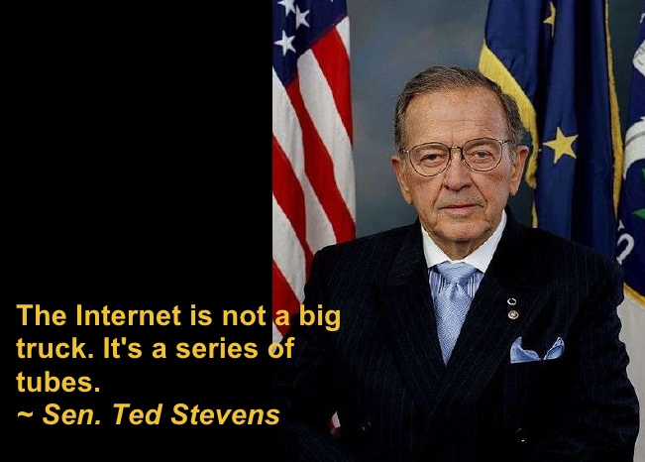
How does the internet work?

Slide 7



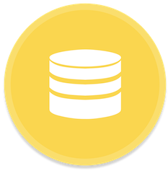
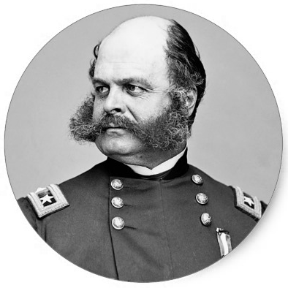



No, seriously. How does it work?
web address
page request
data query
user
browser
server
database
rendered page
page code
data results
aka: client layer
aka: application layer
aka: data layer
Notes:
<we’re pretty much talking web / email only today>
<request>
<server does stuff to generate a response>
<response comes back to you>
<browser puts it all together – static and dynamic>

Slide 8

How do bad guys attack us?
Remember those four components?
  user
  browser
  server
  database
They attack all four layers.
Let’s look at some examples.

Slide 9
Injection Attacks
SQL injection is the most common web attack
  An attacker inserts commands that are used to dynamically construct SQL queries
  Attacker may be able to view or modify any data in a database
Attacks the database by exploiting the application
Any action that takes input from the user and uses it in a query or function may be vulnerable

Slide 10
SQL Injection Scenario

Slide 11
Cross Site Scripting
AKA XSS
Affects the client web browser
Scripting code from attacker is rendered in the page sent by the server
2 types of XSS
  Persistent / Stored: attack code gets stored in the website and affects all users who visit the page
  Non-Persistent / Reflected: attack code does not get stored and can only affect 1 user at a time
Notes:
XSS is the most common client-side vulnerability these days.
Essentially, XSS is a scenario where dynamic client-side content is delivered to the victim's browser. Because the browser has no way to know that the script should not be trusted, it will execute the script. If you can get a browser to load javascript while visiting a site, you can use that javascript to change that site's behavior.
There are two categories of XSS: persistent and non-persistent (or stored and reflected).
In a persistent attack, the content has been uploaded to a website and affects everybody who views that site. Think of a social media site where you're able to upload content. If you were able to upload scripts to run on the client side, you could direct all viewers to execute those scripts upon loading the page. Because it thinks the script came from a trusted source, the malicious script can access any cookies, session tokens, or other sensitive information retained by your browser and used with that site. These scripts can even rewrite the content of the HTML page.
A non-persistent attack has essentially the same effects, but it only targets a single individual at a time. In these cases, the payload is delivered by other means – usually by email.

Slide 12
XSS Scenario

Slide 13
XSS Scenario
Notes:
So what are some of the ways in which XSS can be used?
One of the best resources regarding XSS (and all web application security) is OWASP.
But they sum up some of the potential consequences as the following:
The most severe XSS attacks involve disclosure of the user’s session cookie, allowing an attacker to hijack the user’s session and take over the account. Other damaging attacks include the disclosure of end user files, installation of Trojan horse programs, redirect the user to some other page or site, or modify presentation of content. An XSS vulnerability allowing an attacker to modify a press release or news item could affect a company’s stock price or lessen consumer confidence. An XSS vulnerability on a pharmaceutical site could allow an attacker to modify dosage information resulting in an overdose.
the effects and use of XSS is limited only to the imagination.

Slide 14
Cross Site Request Forgery
AKA CSRF
Affects the client browser
The vulnerability allows an attacker to force the browser to execute website functionality
Leverages the user’s authenticated session on the target website
Notes:
So in XSS, the victim's browser trusts the site that is delivering the malicious payload.
CSRF also depends on trust. However, in this case, it is the website that trusts the victim's browser – and that trust is exploited.
CSRF is an attack which forces an end user to execute unwanted actions on a web application in which he/she is currently authenticated. By sending the victim a carefully constructed link (although POST requests can also be used in CSRF), an attacker may force the users of a web application to execute actions of the attacker's choosing. In this way, the attacker can make the victim perform actions that they didn't intend to, such as logout, purchase an item, change account information, retrieve account information, or any other function provided by the vulnerable website.
In the case of a normal user, a successful CSRF exploit can compromise end user data and operations. If the targeted end user is the administrator, then this can compromise the entire web application.
A good example of mitigations against this type of attack is Amazon.com. You are automatically asked to log into your Amazon.com account any time you need to place an order, access your account or make any changes. This helps prevent unintentional orders from being processed.
Synonyms: CSRF attacks are also known by a number of other names, including XSRF, "Sea Surf", Session Riding, Cross-Site Reference Forgery, Hostile Linking. Microsoft refers to this type of attack as a One-Click attack in their threat modeling process

Slide 15
CSRF Scenario

Slide 16
Authentication and Authorization
Lack of authentication / authorization
Unauthorized data access
Unauthorized system functionality access
Predictable session identifiers
Session Fixation
Session Replay
Brute forcing of credentials
Notes:
Data access – if you're compartmentalizing your data, you don't want everybody to see everything. Lower-level users shouldn't have access to all data on the application. Without proper A&A, maintaining this kind of separation isn't possible.
The same is true for system functionality. You likely don't want to give all users administrator rights to your application. In order to prevent that, users must be properly authenticated and authorized.
Predictable session identifiers:
This attack focuses on predicting session ID values that permit an attacker to bypass the authentication schema of an application. By analyzing and understanding the session ID generation process, an attacker can predict a valid session ID value and get access to the application.
In the first step, the attacker needs to collect some valid session ID values that are used to identify authenticated users. Then, he must understand the structure of session ID, the information that is used to create it, and the encryption or hash algorithm used by application to protect it. Some bad implementations use sessions IDs composed by username or other predictable information, like timestamp or client IP address. In the worst case, this information is used in clear text or coded using some weak algorithm.
In addition, the attacker can implement a brute force technique to generate and test different values of session ID until he successfully gets access to the application.
Session Fixation:
This is where a user is authenticated without invalidating any existing session identifier - this gives an attacker the opportunity to steal authenticated sessions.
Session fixation vulnerabilities occur when:
A web application authenticates a user without first invalidating the existing session ID, thereby continuing to use the session ID already associated with the user.
An attacker is able to force a known session ID on a user so that, once the user authenticates, the attacker has access to the authenticated session.
In the generic exploit of session fixation vulnerabilities, an attacker creates a new session on a web application and records the associated session identifier. The attacker then causes the victim to authenticate against the server using the same session identifier, giving the attacker access to the user's account through the active session.
Session Replay / session Hijack:
The Session Hijacking attack compromises the session token by stealing or predicting a valid session token to gain unauthorized access to the Web Server.
The session token could be compromised in different ways; the most common are:
Predictable session token;
Session Sniffing;
Client-side attacks (XSS, malicious JavaScript Codes, Trojans, etc);
Man-in-the-middle attack

Slide 17
Session Fixation Example

Slide 18
Session Fixation Example

Slide 19

Social Engineering
Impersonation
Lies
Intimidation
Blackmail
etc…
People are often the softest target

Slide 20


How can I defend myself?
YES
NO

Slide 21
Why can’t I hack back?
The supreme art of war is to subdue the enemy without fighting.
Sun Tzu, The Art of War
Notes:
Plus it’s really just a bad idea. You don’t know who’s on the other end and how far they’ll take things. SWATing, etc.

Slide 22

Principles of defense
Reduce your exposure
Trust no one
Secure your tools
Know your environment

Slide 23

Reduce your exposure
What do you need to share?
What do you need to keep?
Where do you need to store data?
Can you reduce the value of your data to others?
“He who defends everything defends nothing.” – Frederick the Great

Slide 24
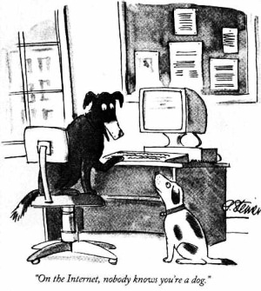
Trust no one
The internet is built to be anonymous.
Verifying identities online is very difficult. Don’t assume you know who’s on the other end.
Extend trust as little as possible.
Never share credentials. Ever. Ever.

Slide 25


Secure your tools
Patch! Patch! Patch!
Uninstall unnecessary tools
  Java
  Flash
  Toolbars
Avoid public Wi-Fi
Use a firewall, AV, password manager, ad blocker, script blocker

Slide 26

Know your environment
Avoid the creepy, dark alleys

Slide 27
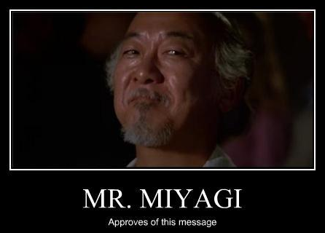
Wrap it up
Nobody has to be a victim
Bad guys are clever, but lazy – most of the time
Take precautions just as you do in real life
  Careful where you surf
  Extend trust sparingly
  Patch!
  View email suspiciously
  Secure your browser
Ask now or contact via email: <myemail>

