Slide 1
findings and friends
Presented by: Rex Booth, Deputy CISO, PBGC
Notes:
Hi folks.
I’m excited to be chatting with you today. We’ll jump right in in a second, but I’ll quickly introduce myself and explain why I’ve been asked to join you.

Slide 2
who is this Rex Booth guy?
New(ish) fed: at PBGC for 18 months
~15 years in IT
~10 years in security
What do I do at PBGC?
Prep us to fight the bad guys
Notes:
My name is Rex Booth – I’m the deputy CISO at PBGC. PBGC is <etc> I’ve been at PBGC for about a year and a half – it’s my first Federal position, though I’ve worked within the Federal space as a consultant for about half of my career.
The general arc of my career <blah blah blah>
Earlier this year I attended a month of executive leadership training at the Harvard Kennedy School. While there we focused on a lot of the softer leadership skills – organizational power structures, communications, behavioral economics, persuasion, etc – all skills that we all need to maximize our career success. Clearly it was an honor and a privilege to attend, and when I returned, I wanted to share what I learned as much as possible. So I started essentially a newsletter that I sent out to a broad set of colleagues at PBGC, <the guy that invited me> among them. These newsletters tried to convey some of the lessons I learned on the various topics we explored during the training and I’m glad to say they were well received. <the guy that invited me> liked them enough that he asked me to condense them into a presentation and share them with you today. So, here I am.
So when I was developing the presentation, I realized I didn’t know my audience very well. And since I don’t work with you all at <host agency> OIG, I wanted to get a feel for what drives you – what motivates you. So I started poking around online and gathered up a handful of OIG mission statements – I figured it was a good place to start to understand what OIGs care about. And this is what I found….

Slide 3
what do IGs care about?
(no-so-random) sample IG mission statements
HHS | To protect the integrity of Department of Health & Human Services programs as well as the health and welfare of program beneficiaries.
DOL | We serve the American Workforce, the Department of Labor, and the Congress by providing independent and objective oversight of Departmental programs through audits and investigations, and by combating the influence of labor racketeering in the workplace.
DOT | The OIG is committed to fulfilling its statutory responsibilities and supporting members of Congress, the Secretary, senior Department officials, and the public in achieving a safe, efficient, and effective transportation system.
FCC | To be an agent of positive change, striving for continuous improvement in FCC's management and program operations.
DOJ | To detect and deter waste, fraud, abuse, and misconduct in DOJ programs and personnel, and to promote economy and efficiency in those programs.
PBGC | Promote excellence in PBGC's operations through the conduct of investigations, audits, and evaluations designed to promote economy, efficiency, and effectiveness and prevent and detect fraud, waste and abuse.
Notes:
<walk through mission statements>

Slide 4
what did I learn?
IGs care about:
Protecting things of value
Stopping bad things from happening (or detecting them after the fact)
Supporting the agency mission
Awesome! Sounds like IGs and agencies should be best friends!
Notes:
So… what did I learn?
Well, these were my take-aways. First, that IGs want to protect things of value. Second, that IGs want to stop bad things from happening or detect them afterwards and extract some lessons learned. And, third, IGs ultimately support the agency mission.
Which in my mind is fantastic! Agencies and their IGs sound like they’re in pretty much perfect alignment when it comes to their focus and missions.
But sadly we know that’s not true. We know there’s friction between OIGs and their respective agencies. Now, some of that friction is intentional – it’s by design. But some of it is waste – it’s unnecessary and counterproductive – it gets in the way of both OIGs and agencies fulfilling their mission in the most effective and efficient way possible.
What’s the source of this friction? Well, I’m sure there’s a multitude of sources, but today we’re going to focus on one: people.

Slide 5
people, process, technology
Most in our field accept this trio as a truth
But what do the terms mean? Specifically, people?
Users?
Developers?
Attackers?
What about security practitioners?
And what about us?
Notes:
In the IT security field – and more broadly in the IT audit and IT fields in general – we preach that IT security is a people, process, and technology problem. And I think that’s true, as do pretty much all practitioners I know of. The problem, in my mind, is two-fold: one, that we allocate resources to those three components unevenly – technology gets the lions share of attention, by far. And, two, that there’s a certain amount of ambiguity about the terms. What do we mean by people process and technology? And, specifically, people?
I submit that when we talk about people, we’re talking about other people. Not us – we’re pointing the finger.
Users… mailicious PDFs, sharing creds
Developers – OWASP
Attackers…
And what about us? Because I posit that if IT security is a people, process and technology problem – and we’re people – then we’re part of the problem. And it’s worth some introspection to see how and why.

Slide 6
specifically..
communications
weight of our words
less is more
context matters
be relevant
relationships
cultivating
defining
Notes:
When it comes to problems created by people, there’s no shortage of issues. So we have to be selective today. I pulled out two themes – communications and relationships. And for each I have a couple thoughts I want to pass along. Some of these thoughts are straight from my leadership training and some I picked up elsewhere along the way. Some may be obvious, but hopefully they’re all relevant and hopefully everybody walks away with something useful that they can apply in their daily work.

Slide 7
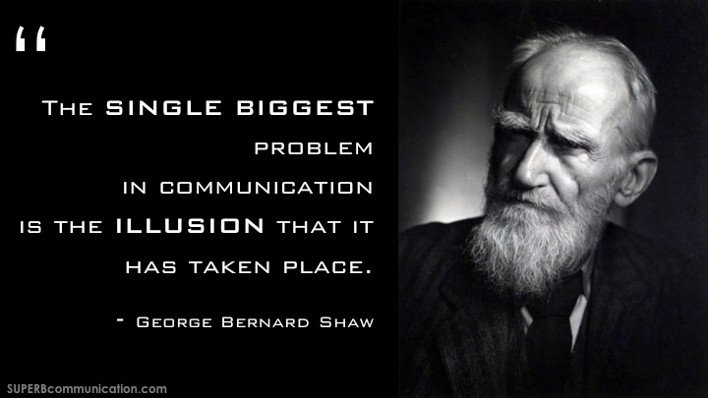
theme one: communication
Notes:
To kick off communications, I just want to share my favorite quote on communications. This is by George Bernard Shaw, the Irish playwright. And I think this gets to the heart of the issue with communications – all too frequently, one or more parties are operating under the assumption that effective communication has occurred when, in fact, it hasn’t.

Slide 8
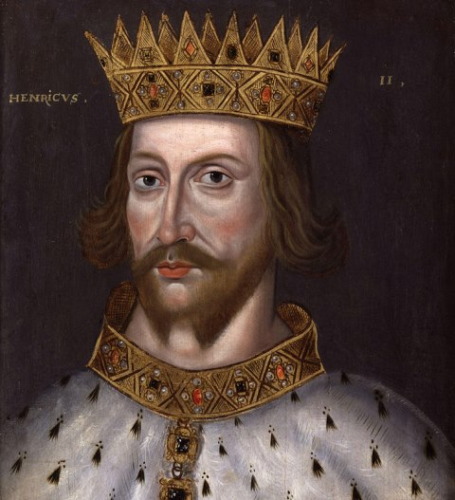
weight of our words
What happens to an agency when an IG says something?
Notes:
To illustrate this dysfunction, I’ll share a tragic historic story.
<details on Thomas Beckett>
Thomas Becket: http://www.eyewitnesstohistory.com/becket.htm

Slide 9
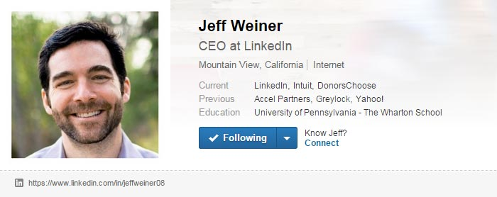
weight of our words
A more modern analogy:
Notes:
There are modern equivalents, too…
http://www.businessinsider.com/linkedin-ceo-jeff-weiner-2014-6
Now, none of us are Kings or CEOs, but we still have to be mindful of the impact of our words. Expecially folks within OIGs. The findings and recommendations that come out of OIGs carry significant weight – often time more than needed or intended. I know that certain folks within PBGC accept IG recommendations as doctrine – that if the IG says to do something, we need to do exactly as recommended. And perhaps that’s often the case, but not always. Agencies should make changes in careful and considered ways – ways that may not always align with industry best practices, but that are nonetheless in the best interest of the agency. But if you have agency personnel that take IG recommendations literally and without and reasonable examination, you’re may have energy and resources wasted on unintended actions. Just like King Henry or Jeff Weiner, we all need to understand how our words carry weight and we need to choose them carefully.

Slide 10
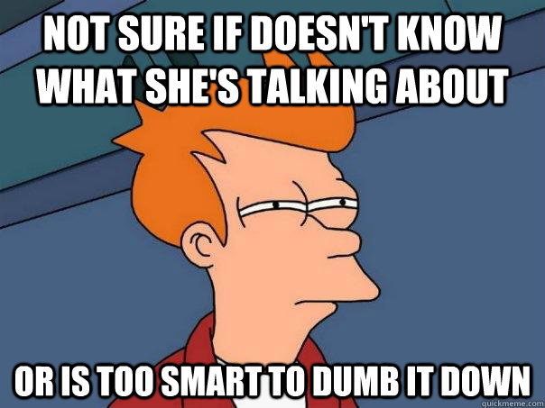
less is more
Notes:
One of the most critical communication principles is simplifying the language we use. I had a professor once who said “don’t use a quarter word when a nickel one will do.” I didn’t fully appreciate it then, but I sure do after years in the consulting and Federal industries.
We all see it every day. Otherwise good ideas obfuscated by overly-complicated language – in presentations, in emails, everywhere. And to what end? The audience is left not knowing if the speaker is trying to sound impressive, is trying to hide something among the impressive words, or is just unable to simplify their language. But they are left with a feeling of disconnect – that the speaker isn’t communicating with their authentic voice. Because, really, when people are being authentic, they don’t use complex sentence structures and terms like synergy, paradigm shift, etc.
There’s a great book called Why Business People Speak Like Idiots which touches upon this in a very approachable way <add some details>. I highly recommend it.

Slide 11
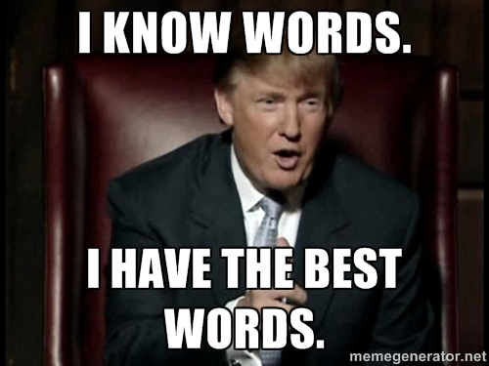
less is more
Notes:
I’ll give a particularly relevant example. We’re in the middle of the Presidential campaign. Politics and poll numbers aside, Trump has demonstrated a remarkable ability to communicate and persuade. How? In part by the language he uses. The Boston Globe did some analysis on the language used by the presidential candidates using this verbal assessment scale called the Flesch-Kincaid Grade Level scale. Based on that analysis, Trump is apparently communicating on a fourth grade level. And he’s not alone. According that same analysis, none of the candidates communicate above the 10th grade level. And it looks like there’s an inverse relationship between the language level and the candidate’s popularity <explain>.
On the other end of the scale, the first paragraph of NIST 800-37 ranks at 19.1 on the Flesch-Kincaid Grade Level scale. This is the paragraph that is supposed to describe “the need for information security and managing risk” – a paragraph, then, that seems not only relatively straightforward to write, but also pretty important to communicate well. If you’re trying to convey your message to the broadest audience possible, I’m pretty sure that opining using doctoral-level language isn’t the most effective approach.
So what can we do?
Communicate like you’re talking to your friends. Don’t try to sound smart, don’t try to impress – just try to communicate. Sure, if you’re talking about a specialized topic, you’ll need to use some specialized language, but that shouldn’t make your whole communication complicated. Use specific, specialized terminology when needed and wrap it with simple, straightforward words. You’re far more likely to engage your audience, sound authentic, and get the kind of response you’re looking for.

Slide 12
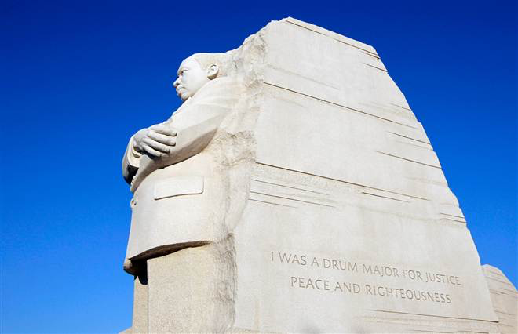
context matters
Yes, if you want to say that I was a drum major, say that I was a drum major for justice, say that I was a drum major for peace, I was a drum major for righteousness, and all the other shallow things will not matter.
Notes:
Another big communication principle is ensuring the appropriate context for a communication. So I ride my bike into DC every morning, and I pass by the tidal basin on my way in. Across the tidal basin is the newest memorial in DC – the one to Dr Martin Luther King Jr. When they designed the memorial, they included a number of inspiring quotes from Dr. King on the side of the massive sculpture. You can read one of them in this photo:
I was a drum major for justice, peace and righteousness.
But he never said those words. Yet they were on the monument when it was first unveiled.
What he actually said – in a speech predicting his own eulogy just 2 months before his assassination – was:
Yes, if you want to say that I was a drum major, say that I was a drum major for justice, say that I was a drum major for peace, I was a drum major for righteousness, and all the other shallow things will not matter.
Pretty different, right? There was a big controversy about this. Maya Angelou said the abbreviated version makes King “look like an arrogant twit.” There was a lot of arguing about what to do, but eventually the paraphrase was removed from the monument.
What does this have to do with our communications?
In the IT security and audit field, we’re frequently required to combine multiple abstract frameworks, align their various components, and distill them into understandable, actionable requirements for others in our organization to follow. Take the risk management framework as an example. There’s at least a half-dozen concepts that converge in a single, umbrella effort. Each concept has its own levels of abstractness and tactical requirements and they all must fit together in an orderly, reasonable fashion. And since NIST is smart enough to avoid being overly prescriptive with this framework and the components, each agency or OIG needs to figure this out for themselves.
It’s not easy. At PBGC, we’ve confused people from day 1 about our approach and we’re still struggling to get it right.
When we communicate, we need to provide the context.
Just like the quote on the King monument, the story around your communication matters. This is simply explaining the “why am I communicating / what am I communicating about” as the first thing you do upon initiating a communication.
And this isn’t important only so people don’t misconstrue the meaning of your words. A 2006 study found that professionals change their tasks about every 3 minutes and they switch across about 12 projects, or “working spheres.” We’re all distracted with too much on our minds. If you’re trying to insert communication into somebody’s brain, some nice introductory context helps ease the transition. Never assume the reader or listener is already on the same page, ready to receive your message. Chances are they’re not. Getting them there ASAP increases the chance that your message will be received as intended.

Slide 13
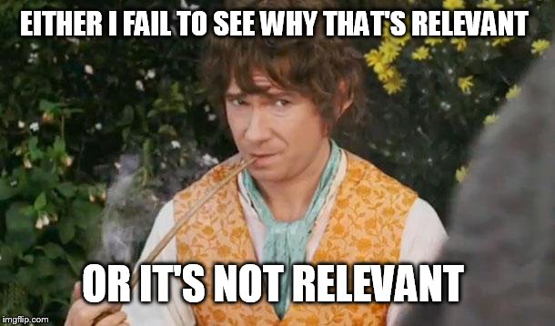
be relevant
Notes:
Finally for communications, I want to encourage everybody to use relevant terms. This is a personal story of mine….
<talk about missing on the performance metrics presented to CISO client>

Slide 14
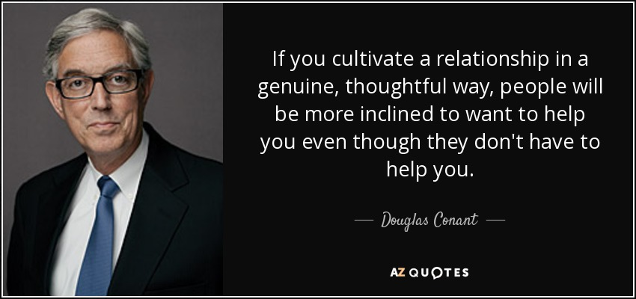
theme two: relationships
Notes:
So, that’s enough communications. Let’s talk relationships.
This quote sums up professional relationships pretty well – at least for our purposes today.
Nothing we do is accomplished in a vacuum. We depend on others to help us accomplish our goals. We need the willing assistance of our colleagues to be successful.
With that in mind, I have two quick thoughts on relationships to share.

Slide 15
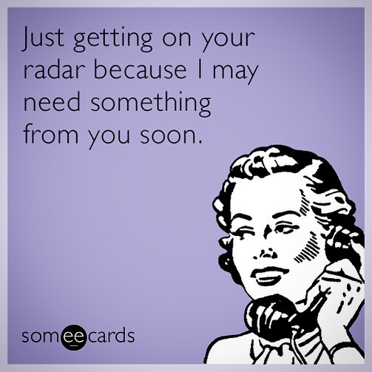
cultivate them
Notes:
I like metaphors, so bear with me a bit on this one.
I’m a big fan of trees, and I’m lucky enough to have a number of large trees on the property around my house. But they’re not just decoration – they’re functional. They keep my house cool. I looked this up – apparently the temperature directly under a tree can be cooled by as much as 25 degrees. They’re awesome.
The problem with trees is that they take a long time to grow. So when we had to remove two dying trees from our lot last year, we lost a bunch of shade with no quick way to regain it. We’ve since planted more trees, but it will take decades to realize the shading and cooling benefits of those new saplings.
The same concept applies to relationships.
The benefits of good relationships are innumerable – laughing at your stupid jokes, hugs, bailing you out of jail – but generally those benefits don’t manifest overnight. Meaning that I can’t reasonably expect the same kind of support from somebody I befriended yesterday as I can from a friend of 20 years.
And even long-standing relationships need constant investment. If I abandon a relationship for an extended period, I shouldn’t expect support when it’s convenient for me. I’m sure we’ve all seen too many relationships deteriorate over time as people take them for granted and fail to invest in them.
So, just like trees, we need to plan and care for our relationships. If we plan on working with individuals in the future, it benefits us to establish and invest in our relationship with them as early as possible. And if we already have a relationship established, we can’t afford to neglect it – we need to nurture it continually so it’s ready for us when we need it.

Slide 16
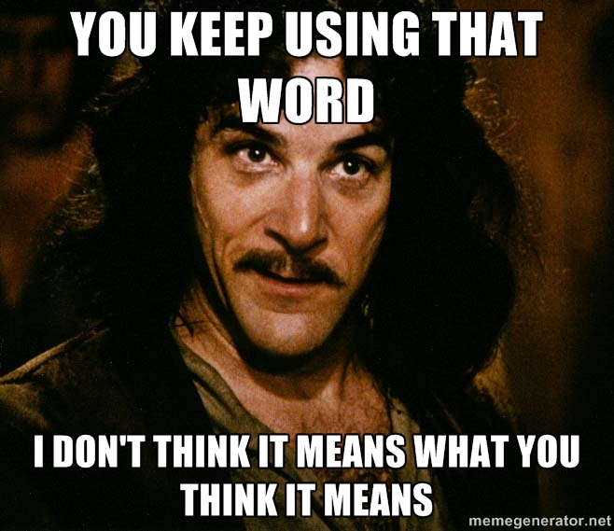
define them
Watch your thoughts, they become words;
watch your words, they become actions;
watch your actions, they become habits;
watch your habits, they become character;
watch your character, for it becomes your destiny.
Notes:
Finally, I want to talk about the importance of how we define relationships.
We have a problem in my division. From an abundance of good intentions, we took on the mantra of “good customer service” and began referring to many of our colleagues throughout the agency as “customers”.
“Customer” has a pretty precise definition – somebody who pays for goods or services. And in that definition, the customer is a goal in and of themselves –you maximize your customers in order to maximize your revenue or profit. To that end, you provide good customer service to make sure that they’re happy, that they return to buy more from you, that they refer others to you, etc. Makes sense, right?
But “customer service” has become shorthand for good relations with somebody to whom you provide something and “customer” has become shorthand for somebody who receives something from you. And that fundamentally mischaracterizes most relationships. A person is not your customer simply because you provide them with the output of your efforts. For somebody to be a customer, your transaction with that person – typically the exchange of money – has to be the fundamental goal of your organization.
So in my opinion, when we call our colleagues customers, we disservice ourselves and them to characterize them as such. Our relationships with them far transcend our transactions.
So what are they?
They’re our partners. Partners share a common goal and both contribute to the pursuit of that goal. For us, we share the common goal of the security of our agency. And our partners contribute to that goal in a multitude of meaningful ways – ways that go far beyond the simple receipt of our work products.
Why spend the time to focus about this?
There’s a pretty awesome quote, variations of which have been ascribed to everybody ranging from Emerson to Buddha to Margaret Thatcher’s dad:
Watch your thoughts, they become words;
watch your words, they become actions;
watch your actions, they become habits;
watch your habits, they become character;
watch your character, for it becomes your destiny.
When we refer to partners as customers, we change the dynamics of the relationship. We focus on the transaction. We place ourselves in a servile position. We lose sight of the shared, common goal. If we’re going to pursue our mission as effectively as possible, we need as many allies – as many partners – as possible. We can’t afford to turn them into mere customers.
I obviously don’t know if that’s a problem you guys have, too, but it’s worth considering. Properly characterizing a relationship is important because it defines how you interact, what you confide in them, and when you can depend on them. You want to make sure you get it right.

Slide 17
things we talked about
communications
weight of our words
less is more
context matters
be relevant
relationships
cultivating
defining
Thanks! My contact info:
@rexbooth
booth.rex@pbgc.gov
Notes:
<summary overview>
<thanks>

